Slide 1
Network Fundamentals

Slide 2
Unguided Media
Unguided media transport electromagnetic waves without using a physical conductor.
This type of communication is often referred to as wireless communication.
Signals are normally broadcast through air and thus are available to anyone who has a device capable of receiving them.

Slide 3
Unguided Media
Unguided signals can travel from the source to destination in several ways.
There is ground propagation (below 2 MHz), sky propagation (2-30 MHz) and line-of-sight propagation (above 30 MHz).

Slide 4
Unguided Media
In ground propagation, radio waves travel through the lowest portion of the atmosphere, hugging the earth.
These low-frequency signals emanate in all directions from the transmitting antenna and follow the curvature of the planet.
Distance depends on the amount of power in the signal. The greater the power, the greater the distance.

Slide 5
Unguided Media
In sky propagation, higher-frequency radio waves radiate upward into the ionosphere (the layer of atmosphere where particles exist as ions) where they are reflected back to earth. This transmission allows for greater distances with lower power output.

Slide 6
Unguided Media
In line-of-sight propagation, very high-frequency signals are transmitted in straight lines directly from antenna to antenna.
Antennas must be directional, facing each other, and either tall enough or close enough together not to be affected by the curvature of the earth.

Slide 7
Unguided Media
The electromagnetic spectrum defined as radio waves and microwaves is divided into eight ranges, called bands, each regulated by government authorities.

Slide 8
Unguided Media
We can divide wireless transmission into three broad groups:
Radio waves
Microwaves
Infrared waves

Slide 9
Radio Waves
The electromagnetic waves ranging in frequencies between 3 KHz and 1 GHz are normally called radio waves.
Radio waves, for the most part, are omni directional.

Slide 10
Radio Waves
When an antenna transmits radio waves, they are propagated in all directions.
This means that the sending and receiving antennas do not have to be aligned.

Slide 11
Radio Waves
A sending antenna can send waves that can be received by any receiving antenna.
Radio waves, particularly those waves that propagate in the sky mode, can travel long distances.

Slide 12
Radio Waves
This makes radio waves a good candidate for long-distance broadcasting such as AM/FM radio.
Radio waves, particularly those of low and medium frequencies, can penetrate walls.

Slide 13
Radio Waves
This characteristic can be both an advantage and disadvantage.
It is the advantage because, for example an AM radio can receive signals inside a building.

Slide 14
Radio Waves
It is a disadvantage because we cannot isolate a communication to just inside or outside a building.
The radio wave band is relatively narrow, just under 1 GHz, compared to the microwave band.

Slide 15
Radio Waves
Almost the entire band is regulated by authorities.
Using any part of the band requires permission from the authorities.

Slide 16
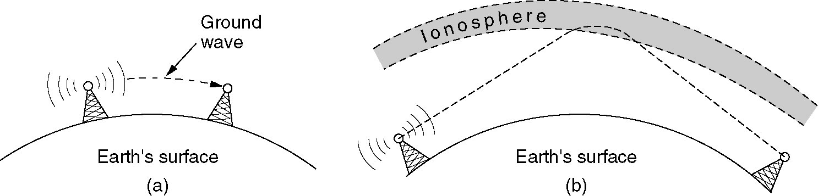
Radio Transmission
(a) In the VLF, LF, and MF bands, radio waves follow the curvature of the earth.
(b) In the HF band, they bounce off the ionosphere.

Slide 17

Omni directional Antenna
Radio waves use omni directional antennas that send out signals in other directions.
Based on wavelength, strength, and the purpose of transmission, we can have several types of antennas.

Slide 18
Microwaves
Electromagnetic waves having frequencies between 1 and 300 GHz are called microwaves.
Microwaves are unidirectional.
When antenna transmits microwave waves, they can be narrowly focused.
This means that the sending and receiving antennas need to be aligned.

Slide 19
Microwaves
The unidirectional property has an obvious advantage.
A pair of antennas can be aligned without interfering with another pair of aligned antennas.
Microwave propagation is line-of-sight.

Slide 20
Microwaves
Since the towers with the mounted antennas need to be in direct sight of each other, towers that are far apart need to be vary tall.
The curvature of the earth as well as other blocking obstacles do not allow two short towers to communicate using microwaves.

Slide 21
Microwaves
Repeaters are often needed for long-distance communication.
Very high-frequency microwaves cannot penetrate walls.
This characteristic can be a disadvantage if receivers are inside buildings.

Slide 22
Microwaves
The microwave band is relatively wide, almost 299 GHz.
Therefore wider sub bands can be assigned, and a high data rate is possible.
Use of certain portions of the band requires permission from authorities.

Slide 23
Unidirectional Antenna
Microwaves need unidirectional antennas that send out signals in one direction.
Two types of antennas are used for microwave communications
The parabolic dish
The horn

Slide 24
Unidirectional Antenna
A parabolic dish antenna is based on the geometry of a parabola.
The parabolic dish works as a funnel, catching a wide range of waves and directing them to a common point.
So more of the signal is recovered than would be possible with a single-point receiver.

Slide 25
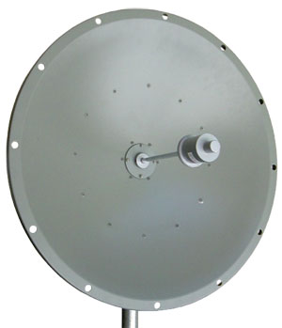
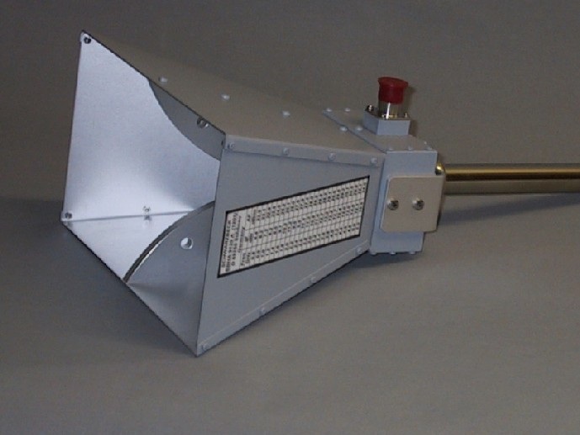
Parabolic Dish Antenna
Horn Antenna

Slide 26
Unidirectional Antenna
A horn antenna looks like a gigantic scoop.
Outgoing transmissions are broadcast up a stem and deflected outward in a series of narrow parallel beams by a curved head.
Received transmissions are collected by the scooped shape of the horn and are deflected down into the stem.

Slide 27
Applications
Due to their unidirectional properties, they are very useful when unicasting (one-to-one) communication is needed between the send and receiver.
Used in cellular phones, satellite networks and wireless LANs.

Slide 28
Infrared waves
Infrared signals, with frequencies from 300 GHz to 400 THz, can be used for short range communication.
Infrared signals, having high frequencies, cannot penetrate walls.

Slide 29
Infrared waves
This advantageous characteristic prevents interference between one system and another; a short-range communication system in one room cannot be affected by another system in the next room.

Slide 30
Infrared waves
When we use our infrared remote control, we do not interfere with the use of the remote by our neighbors.
This characteristic makes infrared signals useless for long range communication.

Slide 31
Infrared waves
We cannot use infrared waves outside a building because the sun’s ray contain infrared waves that can interfere with the communication.

Slide 32
Applications
The infrared band, almost 400 THz, has an excellent potential for data transmission.
Such a wide bandwidth can be used to transmit digital data with a very high data rate.

Slide 33
Applications
The Infrared Data Association (IrDA) has established standards for using these signals for communication between devices such as keyboards, mice, PCs and printers.

Slide 34
Applications
For example, some manufacturers provide a special port called the IrDA port that allows a wireless keyboard to communicate with a PC.
The standard originally defined a data rate of 75 Kbps for a distance up to 8 m.
The recent standard defines a data rate of 4 Mbps.

Slide 35
Lightwave Transmission
Unguided optical signaling has been in use for centuries.
A more modern application is to connect the LANs in two building via lasers mounted on their rooftops.
Coherent optical signaling using lasers is inherently unidirectional, so each building needs it sown laser and its own photodetector.

Slide 36
Lightwave Transmission
This scheme offers very high bandwidth and very low cost.
It is also relatively easy to install, and unlike microwave, does not require a license.
The laser’s strength, a very narrow beam, is also its weakness here.

Slide 37
Lightwave Transmission
Lenses are put into the system to defocus the beam slightly.
A disadvantage is that laser beams cannot penetrate rain or thick fog, but they normally work well on sunny days.
Heat from the sun during the daytime caused convection currents to rise up from the roof of the building.

Slide 38
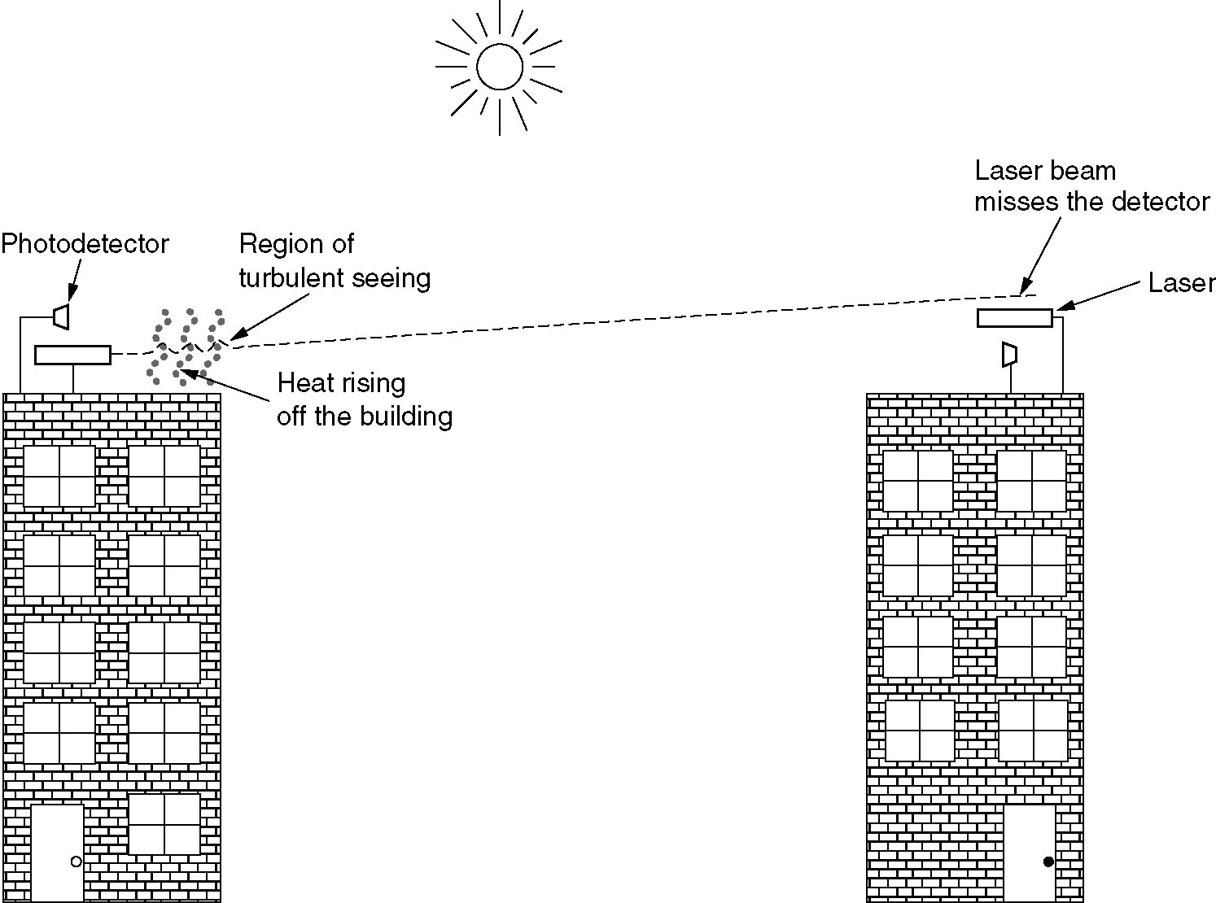
Lightwave Transmission
Convection currents can interfere with laser communication systems.

Slide 39
Wireless Transmission
The Electromagnetic Spectrum
Radio Transmission
Microwave Transmission
Infrared and Millimeter Waves
Lightwave Transmission

Slide 40
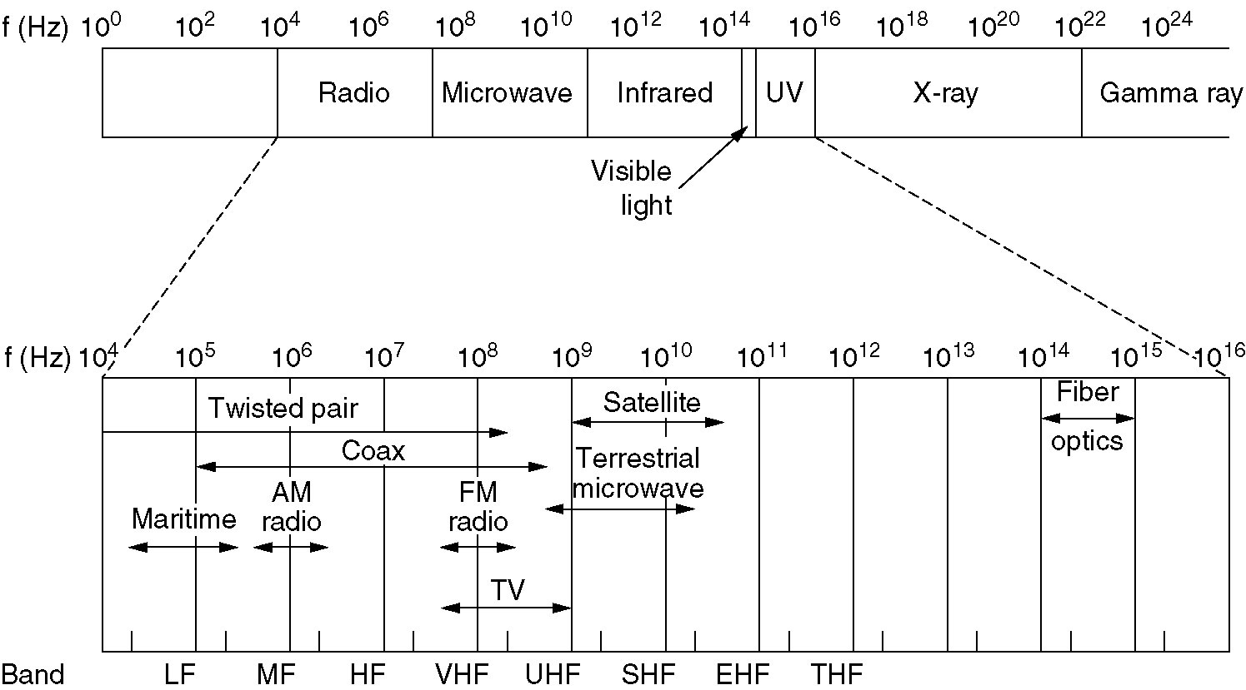
The Electromagnetic Spectrum
The electromagnetic spectrum and its uses for communication.

Slide 41
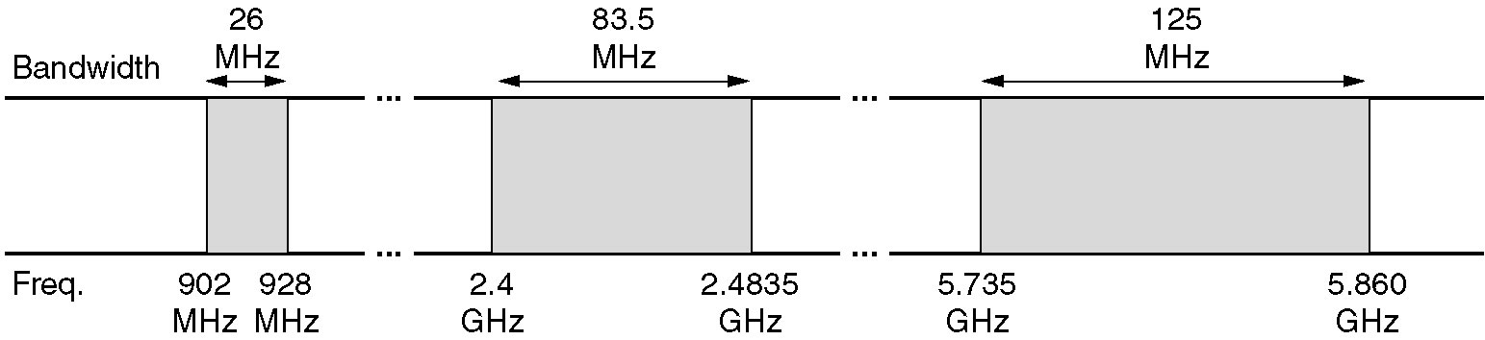
Politics of the Electromagnetic Spectrum
The ISM bands in the United States.

Slide 42
Lightwave Transmission
Convection currents can interfere with laser communication systems.
A bidirectional system with two lasers is pictured here.

Slide 43
Communication Satellites
Geostationary Satellites
Medium-Earth Orbit Satellites
Low-Earth Orbit Satellites
Satellites versus Fiber

Slide 44
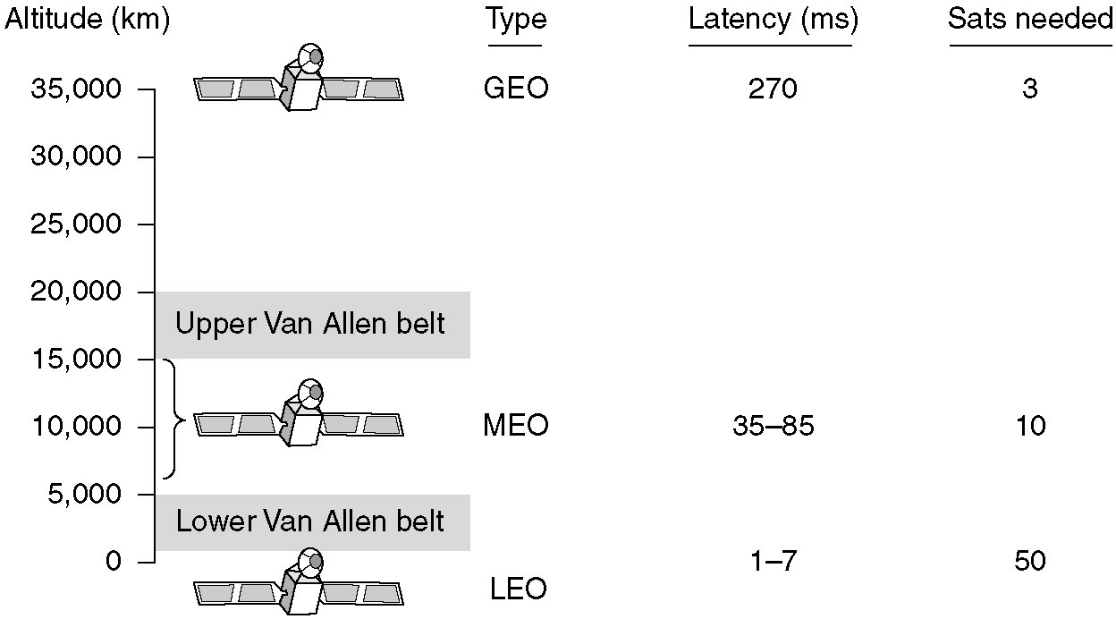
Communication Satellites
Communication satellites and some of their properties, including altitude above the earth, round-trip delay time and number of satellites needed for global coverage.

Slide 45
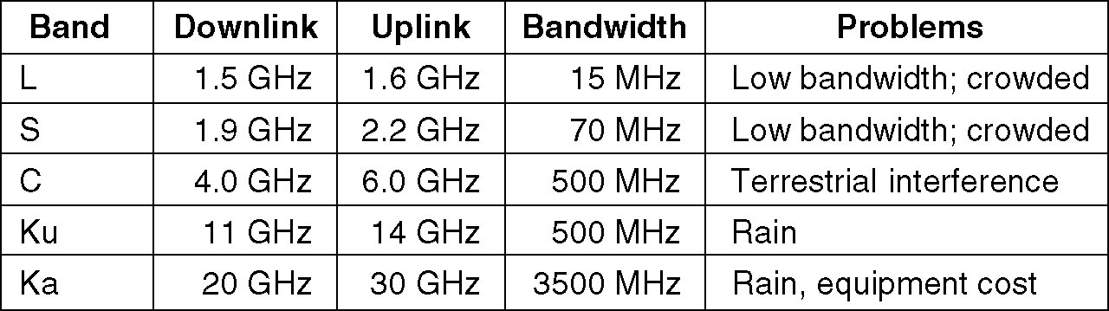
Communication Satellites (2)
The principal satellite bands.

Slide 46
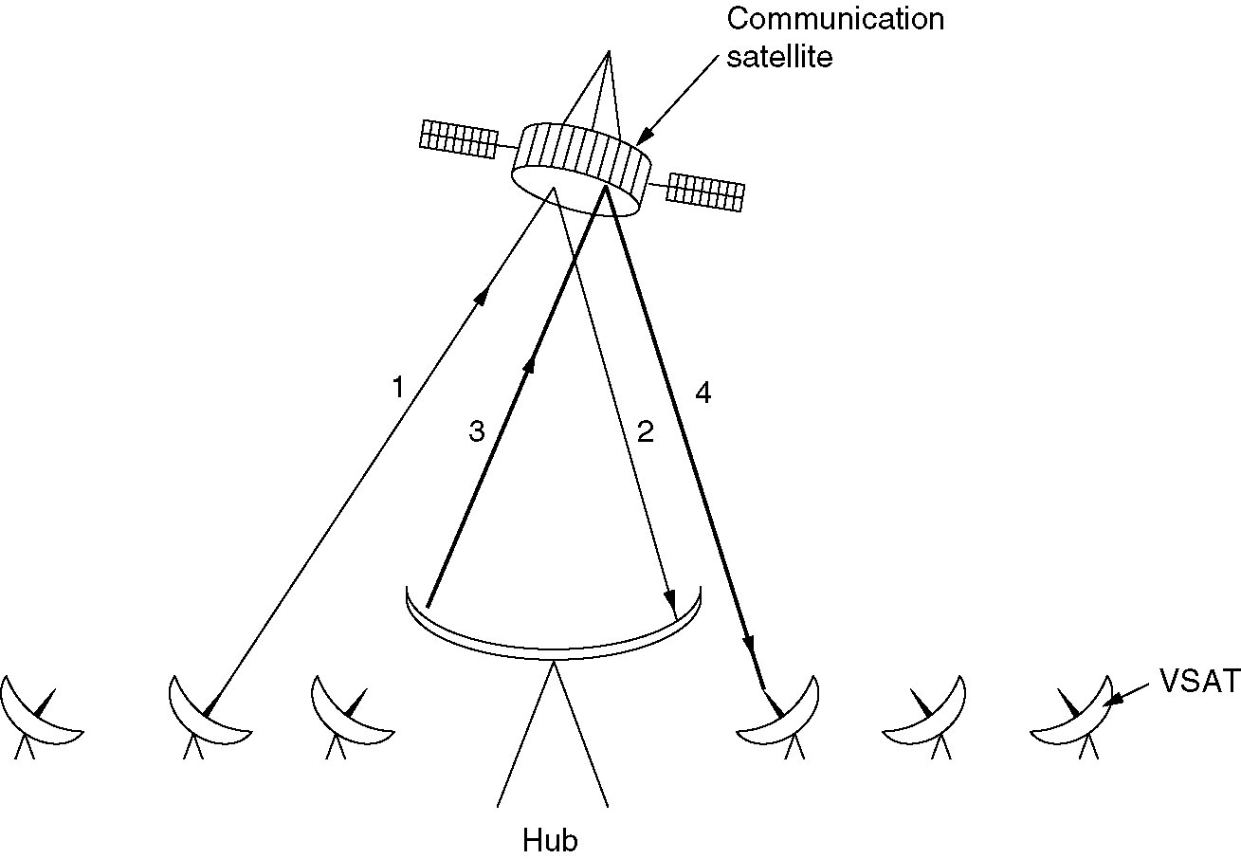
Communication Satellites (3)
VSATs using a hub.

Slide 47
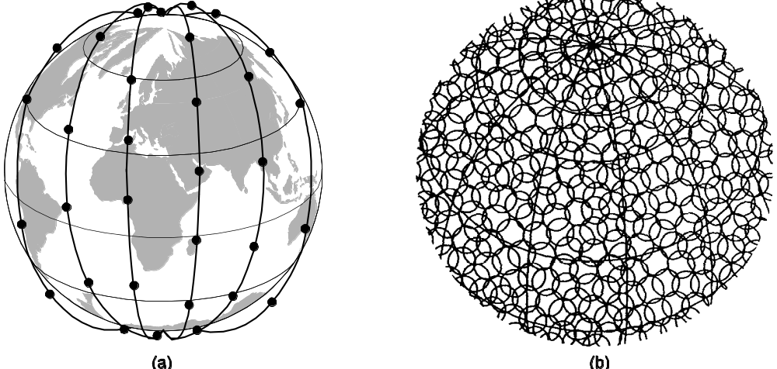
Low-Earth Orbit Satellites
Iridium
(a) The Iridium satellites from six necklaces around the earth.
(b) 1628 moving cells cover the earth.

Slide 48
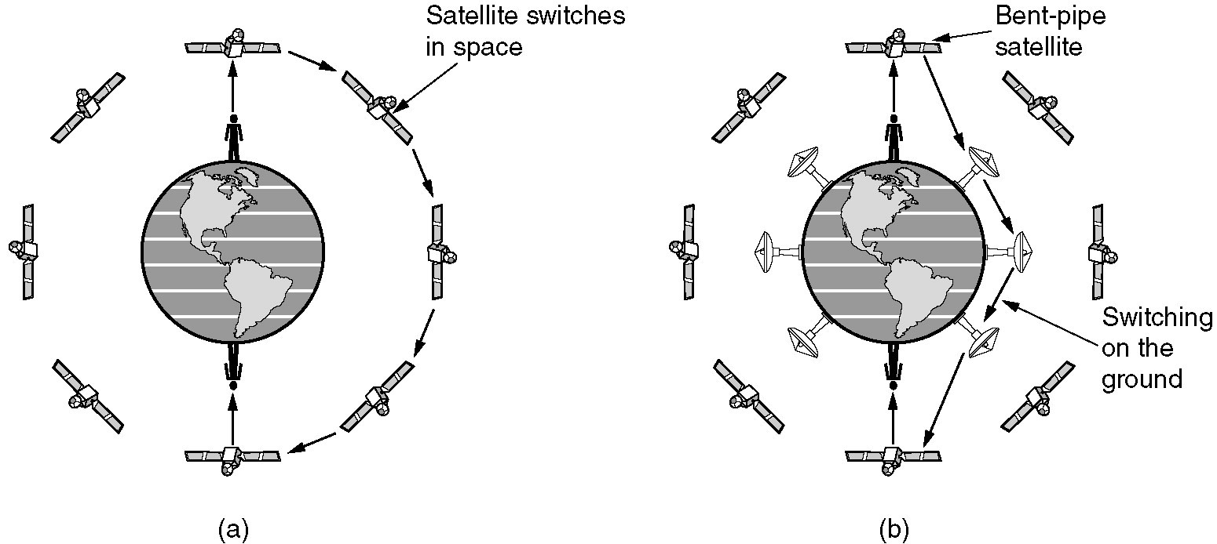
Globalstar
(a) Relaying in space.
(b) Relaying on the ground.

